Slide 1

Classification of Genetic Risk for
Pediatric Acute Myeloid Leukemia
Health Hackers
Mahmoud Hamza
Minerva Panda
Úrsula Pérez
Hirza Pimentel
Marwa Qabeel

Slide 2
Introduction
Introduction
level of genetic risk
for pediatric AML
karyotype
Genes
FLT3 (Fms-like tyrosine kinase 3)
NPM (nucleophosmin)
FLT3 > 0.4?
Yes
high risk
No
NPM mutation?
Yes
MOTIVATION
Knowing the genetic risk level for pediatric acute myeloid leukemia (AML) will allow patients to receive the most effective treatment.
AIM
To classify the level of genetic risk for pediatric AML according to medical established criteria and explore the attributes more responsible for each risk level.
HYPOTHESES for risk level of pediatric AML
Being older is not associated with a higher risk level, it is genetics-related.
Translocation t(8;21) is the most frequent cause of low risk.
FLT3 mutation is the most responsible cause for high risk (age > 10 years old in the references).
low risk
No
Down syndrome and 4 years old or over?
Yes
low risk
No
lack of
abnormalities
Yes
standard risk
No
DNA fragments
inv: inversion
t: translocation
chromosomes
monosomy (-5, -7)
deletion (-5q, -7q)
inv(16)
or t(8;21)
Yes
low risk
No
any of:
-5, -5q, -7, -7q
Yes
high risk
No
Yes
4 or more unique abnormalities
high risk
No
standard risk
© 2017 Udacity. All rights reserved.

Slide 3
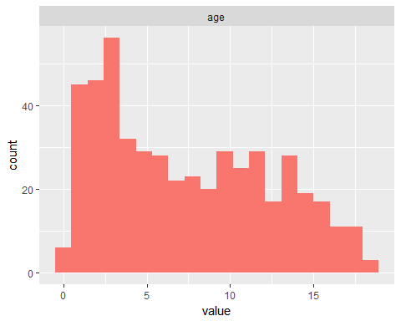
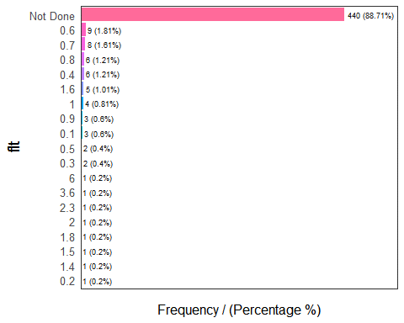
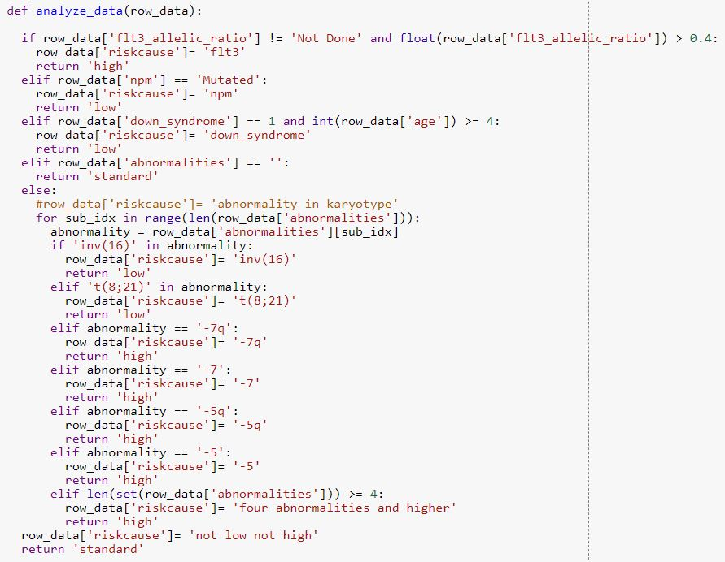

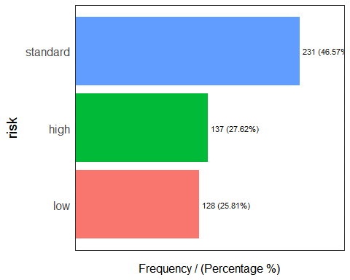
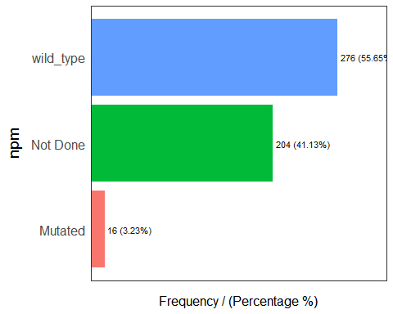

Material & Methods
Sample characteristics Methods
504 patients from a hospital in Egypt.
Data cleaning and extracting useful features from data for analyses
Classification algorithm for assigning risk scores for pediatric AML to patients, based on the standard medical regulations.
0 5 10 15
age (years old)
Code link: https://goo.gl/643Qhg
C) Statistical analyses (descriptive statistics and Kendall’s Tau correlation)
© 2017 Udacity. All rights reserved.

Slide 4
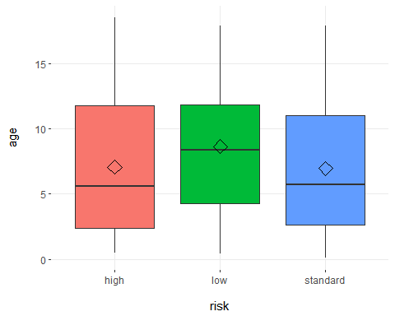
Results & Conclusions
age vs. risk level
Kendall’s Tau correlation = -0.032 (p-value = 0.36)
Age is not statistically associated with risk level (p-value = 0.36), with a Kendall’s Tau correlation value close to zero (-0.032). Therefore, older and younger infants are almost equally predisposed to a low/standard/high risk level of pediatric AML.
This is in accordance with our hypothesis: the risk level is genetics-related but not age-related.
All the patients were correctly classified as expected, following the medical criteria.
© 2017 Udacity. All rights reserved.

Slide 5
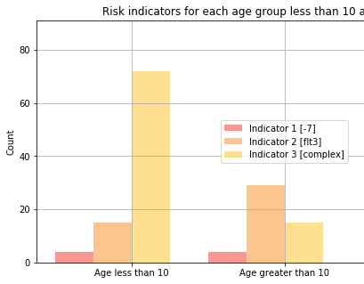
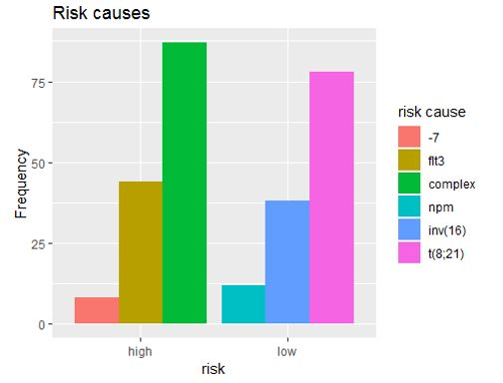
Results & Conclusions
b) risk causes for high and low risk levels
Four or more unique abnormalities (complex karyotyping) was the most frequent risk cause for the high risk of pediatric AML considering all age ranges. We hypothesized that FLT3 would be the most frequent cause, but this is only true for patients greater than 10 years old.
For low risk of pediatric AML, the translocation t(8;21) was the most frequent cause. This is in accordance with our hypothesis.
age rank | high: FLT3
(0,10] | 15/91
(10,18.5] | 29/48
Future work: to predict FLT3 value (lower or greater than 0.4) from the other variables with machine learning techniques. FLT3 is crucial to know the risk level but requires a long analysis in the laboratory.
© 2017 Udacity. All rights reserved.

Slide 6
References
Stack Overflow contributors, Correlation between continuous and categorical variables in Python; 07/20/2018; (https://stackoverflow.com/questions/44694228/how-to-check-for-correlation-among-continuous-and-categorical-variables-in-python)
Panagiotis D. Kottaridis and others, The presence of FLT3 in patients with (AML); 07/18/2018; (http://www.bloodjournal.org/content/98/6/1752.full?sso-checked=true)
Kalliopi N. Manola, Cytogenetics of pediatric acute myeloid leukemia; 07/21/2018; (http://onlinelibrary.wiley.com/doi/10.1111/j.1600-0609.2009.01308.x/pdf)
Children’s oncology group, COG AAML0531 for newly diagnosed Acute Myeloid Leukemia in Children; 07/18/2018; (https://www.childrensoncologygroup.org/index.php/aaml0531/)
Marry van den Heuvel-Eibrink et al., Pediatric AML: From Biology to Clinical Management; 07/18/2018; (http://www.mdpi.com/2077-0383/4/1/127)
Hamid Bolouri and others, Comprehensive characterization of pediatric AML reveals diverse fusion oncoproteins and age-specific mutational interactions; 07/18/2018;(https://www.biorxiv.org/content/early/2017/10/10/125609)
© 2017 Udacity. All rights reserved.

